Slide 1
E-commerce Analytics Dashboard
Presented by:
👤 Tammana Triveni (under guidance of Arul Sir)
Technologies & Tools Used:
Python
BigQuery (GCP)
Streamlit
MySQL
Git
Organisation:Revature
Date: 25-03-2025
.

Slide 2
Contents
Abstract
Key goals
Implementation
Schema
Snapshots
Conclusion
Future Scope

Slide 3
Abstract
Data Foundation: Event-driven Data Pipeline for E-commerce is designed to efficiently capture, process, and analyze ecommerce events in real time. The system ingests user interaction events and transaction data from multiple sources, transforming them using Python and storing them in BigQuery with an optimized schema for event analytics.
This pipeline ensures incremental loading, robust error handling, and provides specialized data marts for diverse analytical perspectives of the customer journey. Synthetic event generation (via the Faker library) and historical data (from the Brazilian E-Commerce Public Dataset) serve as key data sources.
Leveraging technologies like Python, BigQuery, MySQL, and Streamlit, this solution enables real-time data processing, visualization, and insightful analysis of e-commerce activities. The project aims to deliver a scalable and efficient event-driven architecture, supporting advanced analytics and business intelligence for e-commerce platforms.

Slide 4
Key goals
Displaying Historical
Order Data & events
Live Events Generation using Faker
Events from
Brazilian Dataset
Dashboard using
Streamlit

Slide 5
Implementation
Order
Summary
Event
Metrics
Live
Data
Stream
Performance
Overview

Slide 6
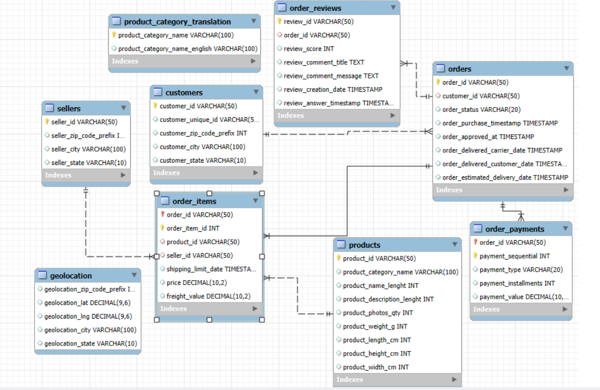
Schema
ive
Data
Stream

Slide 7
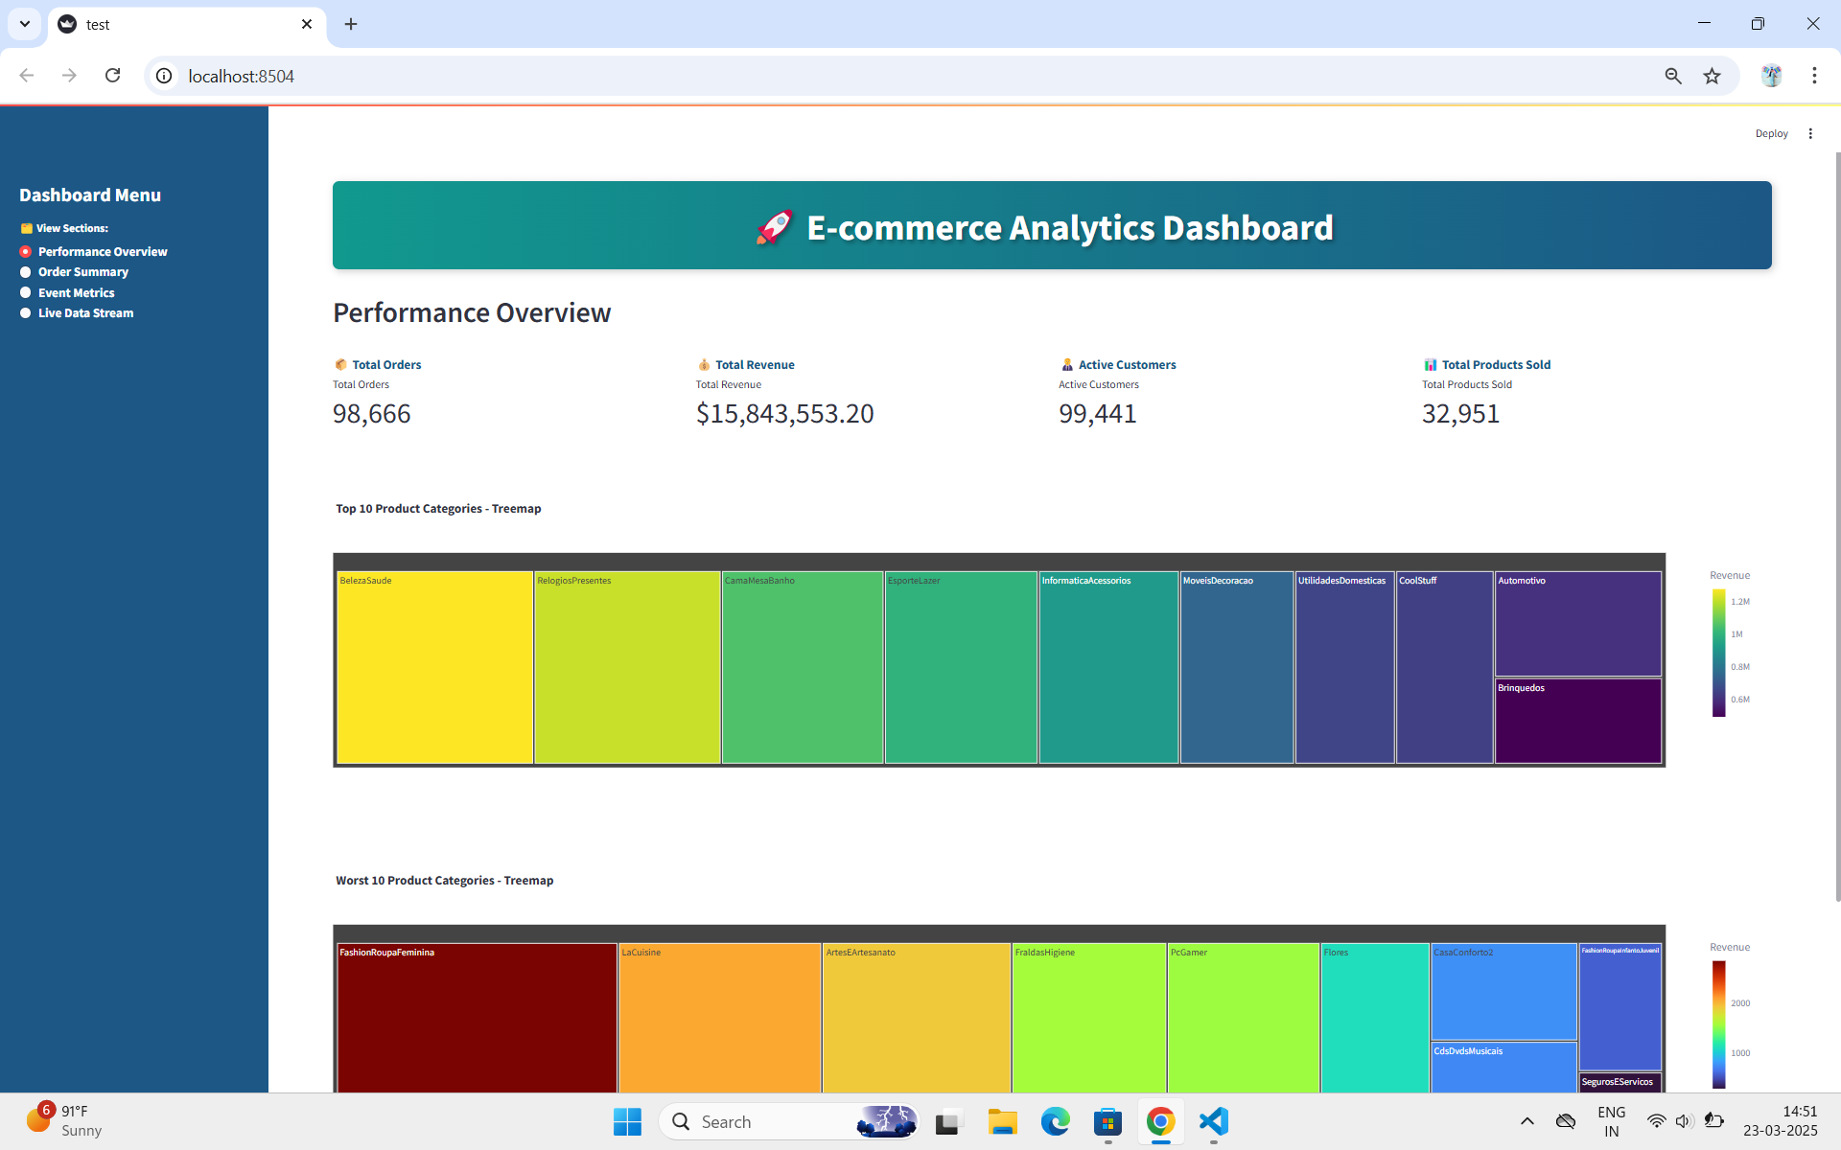
SnapShots
Performance Overview:Showing Top 10 best,worst products and Total Revenue,Total Orders and Active Customers in E-commerce Website

Slide 8
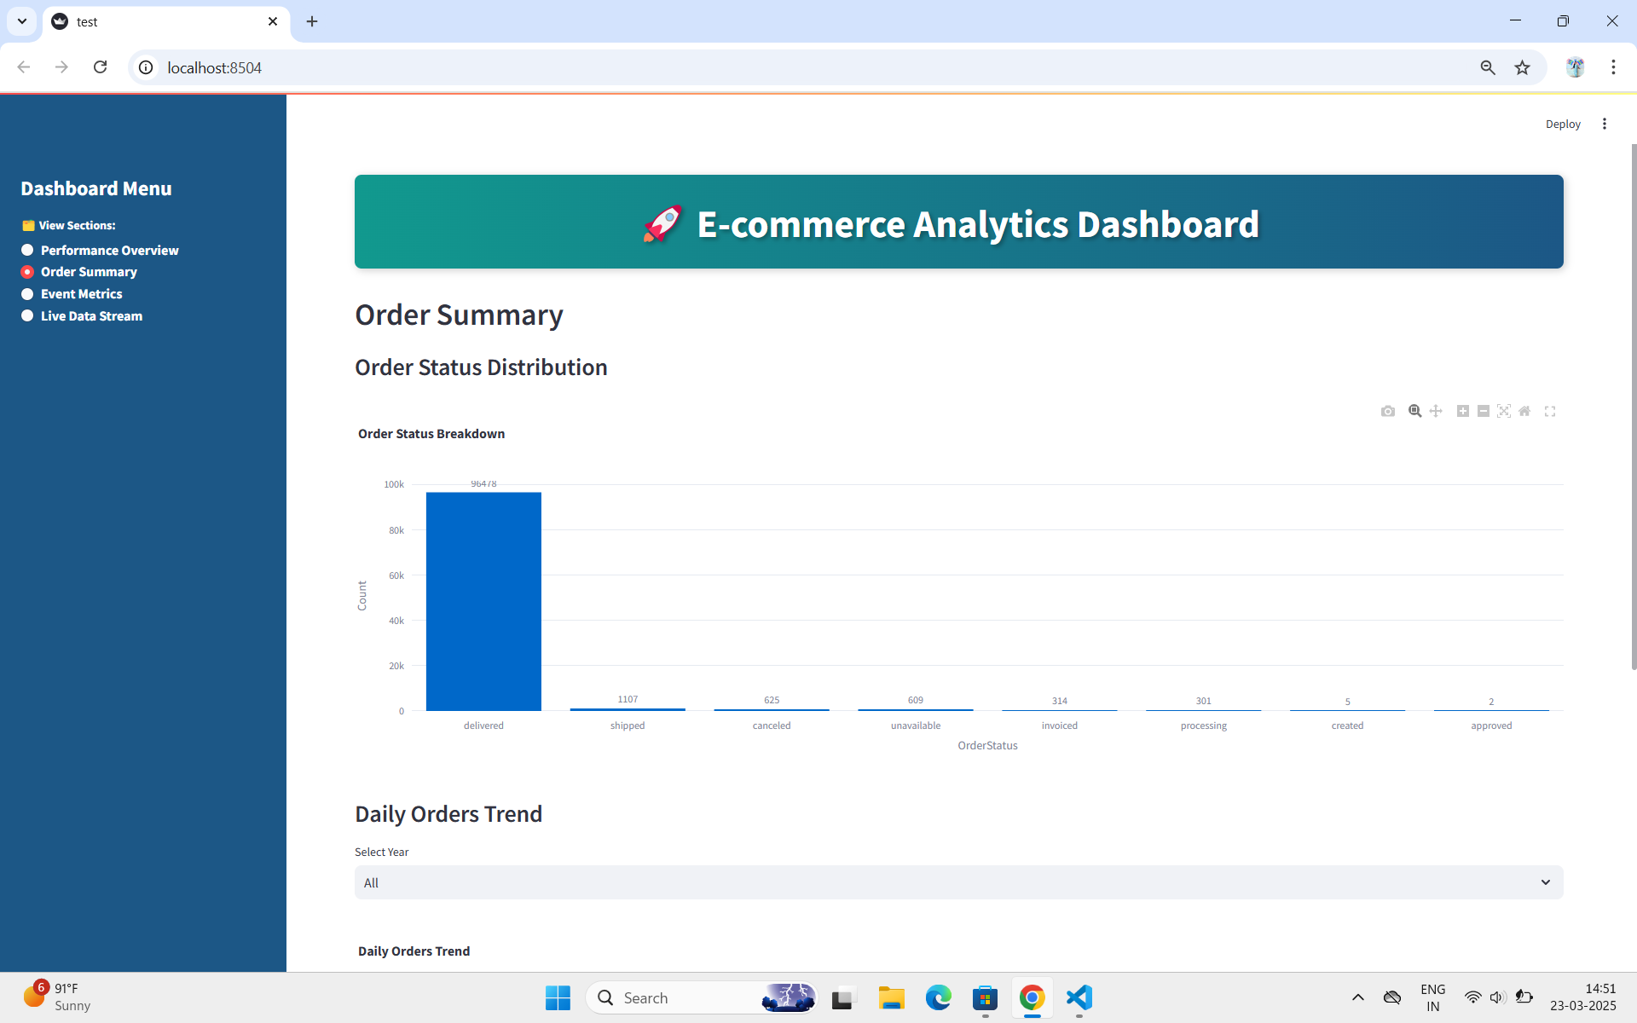
SnapShots
Order Summary:Showing Order Status Distribution and based on Year it shows the Daily Orders Trends of all Customer actions in E-commerce

Slide 9
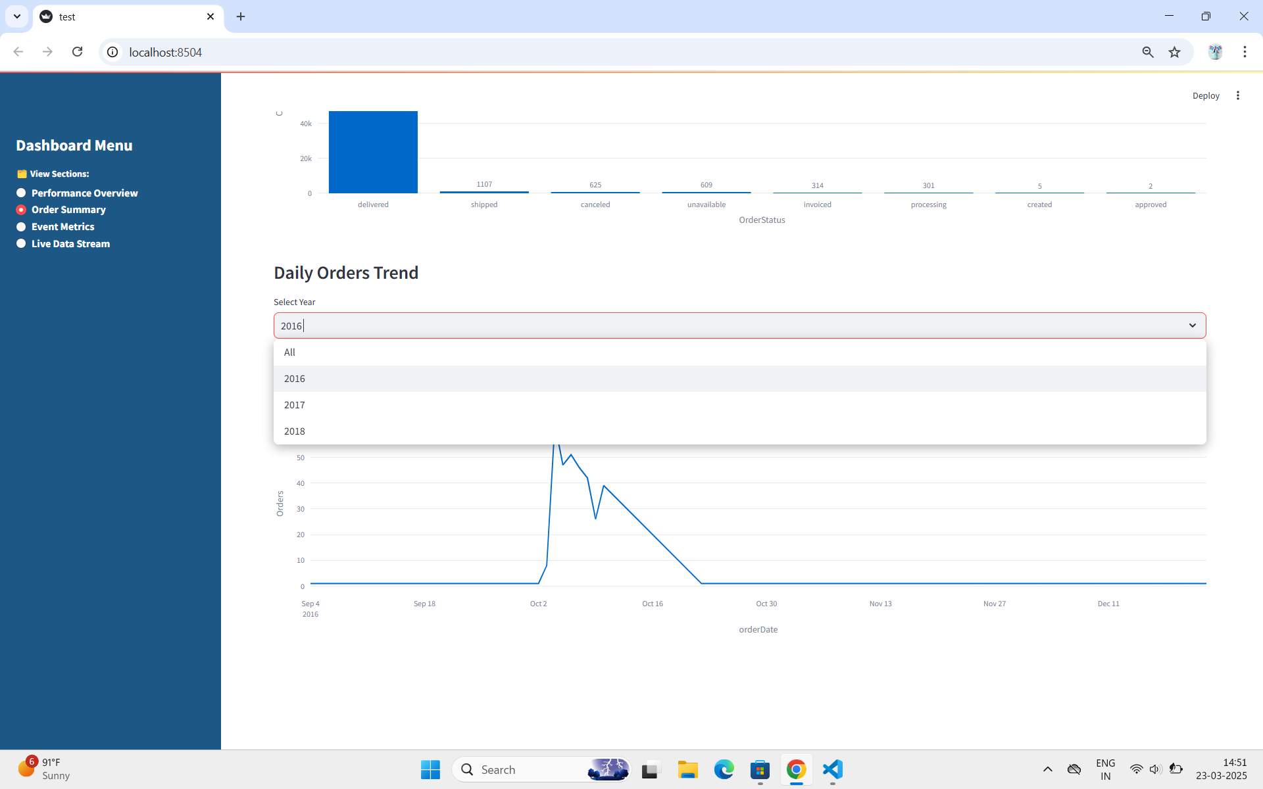
SnapShots
Order Summary: Filtering the OrderDate from 2016,2017 and 2018 (Old Data)

Slide 10
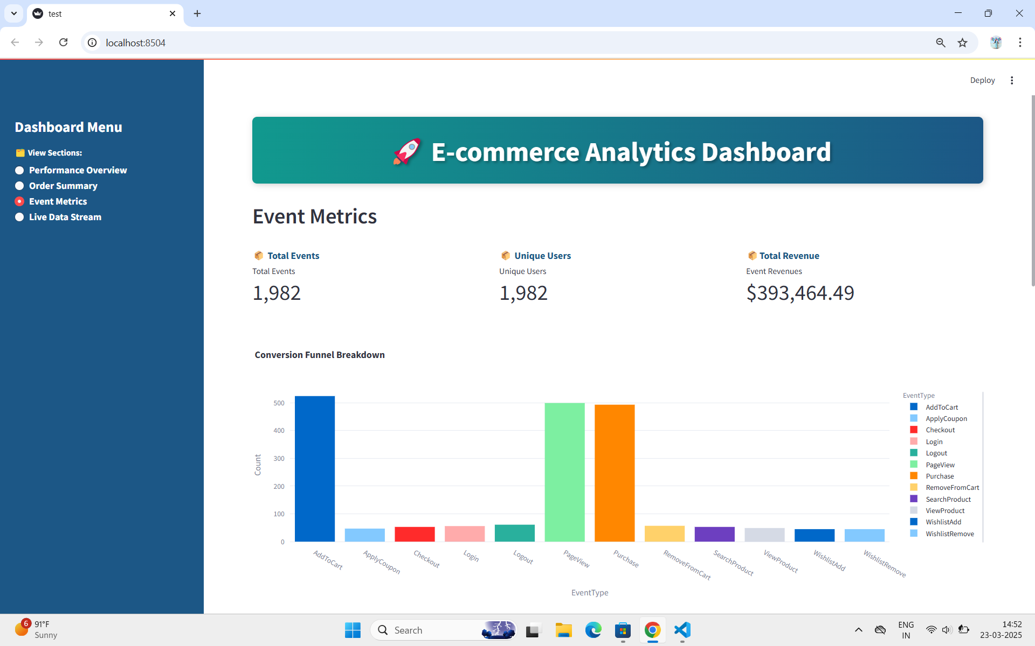
SnapShots
Event Metrics: Showing Total Events,Unique Users and Total Revenue and Event Types

Slide 11
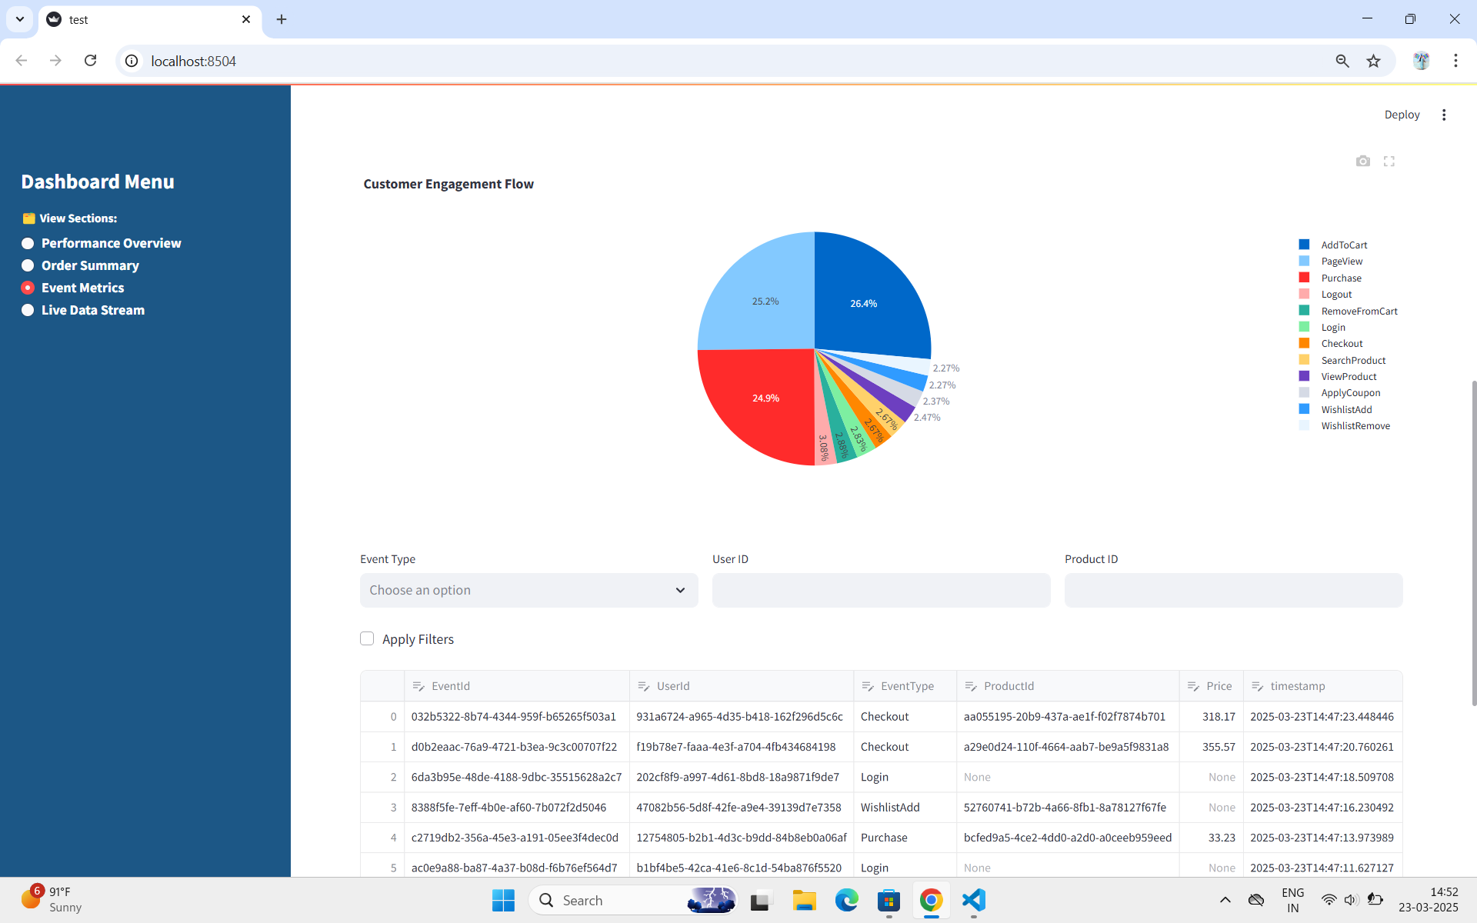
SnapShots
Event Metrics: Showing Customer Engagements Flow in various Events of E-commerce

Slide 12
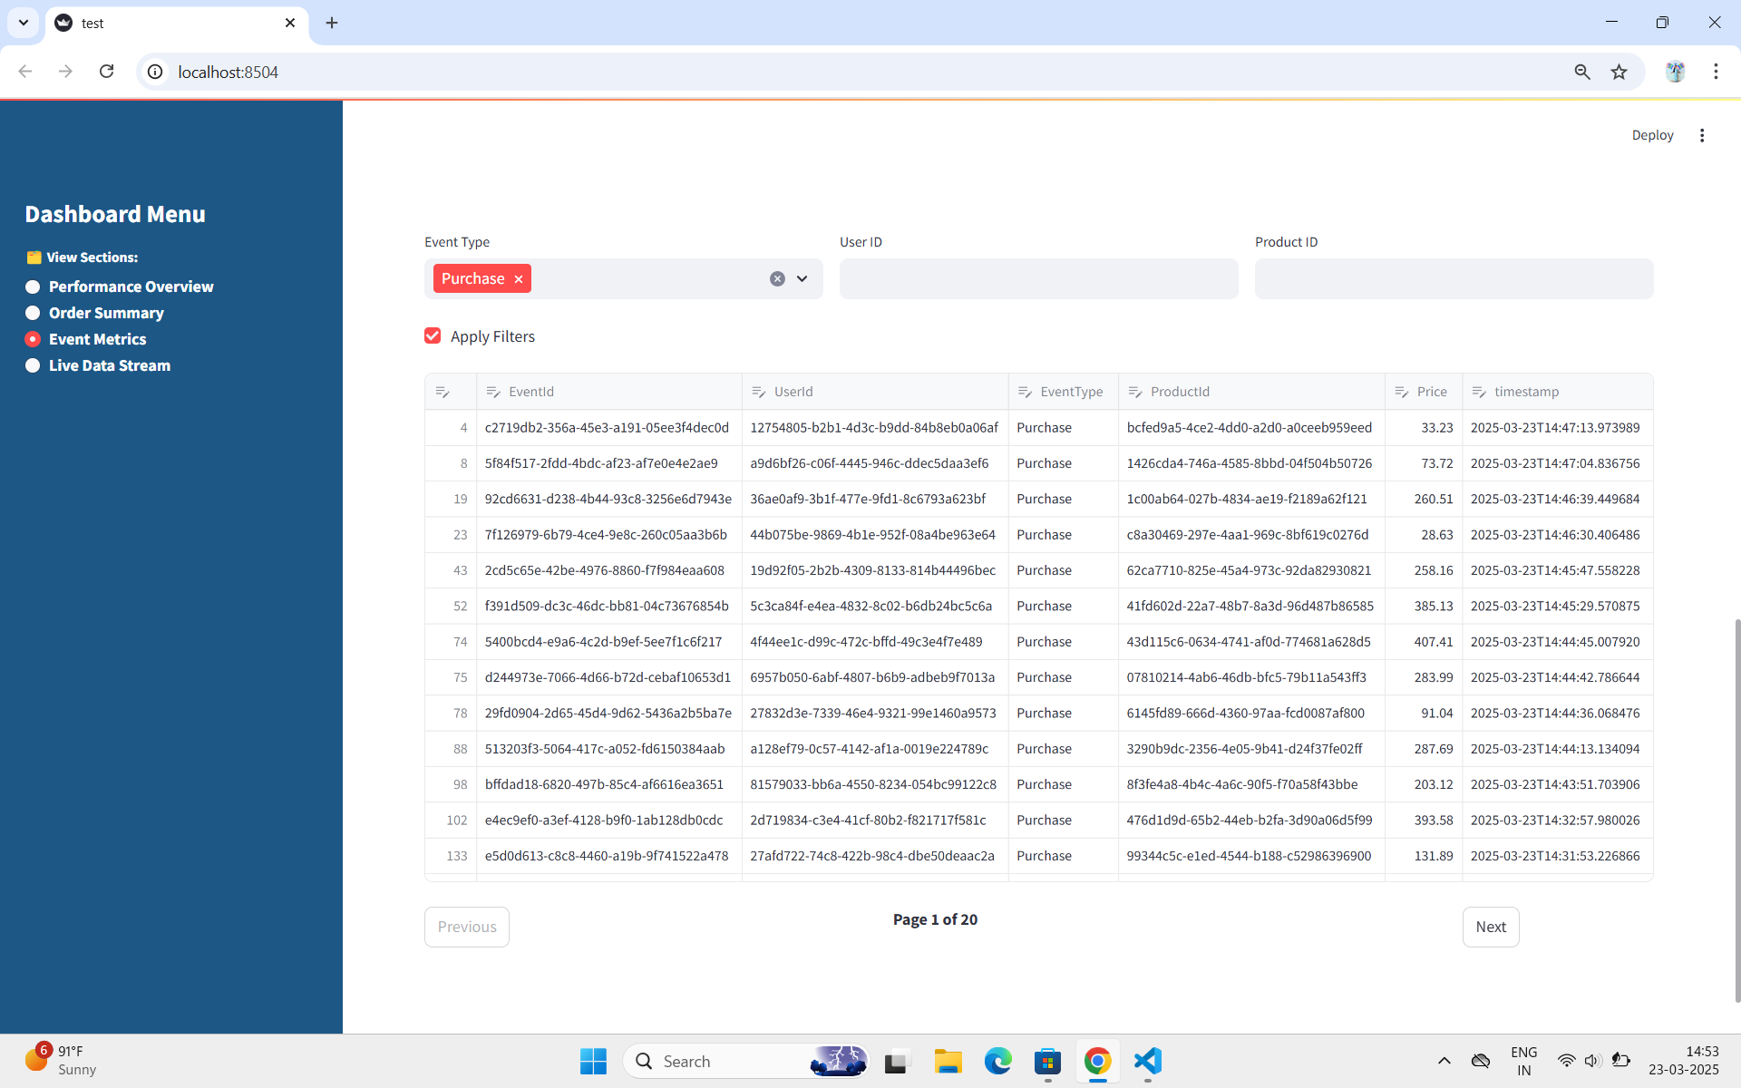
SnapShots
Event Metrics: Sorting & Filtering columns and Pagination in table

Slide 13

SnapShots
Event Metrics: Searching and Full Screen options in table itself

Slide 14
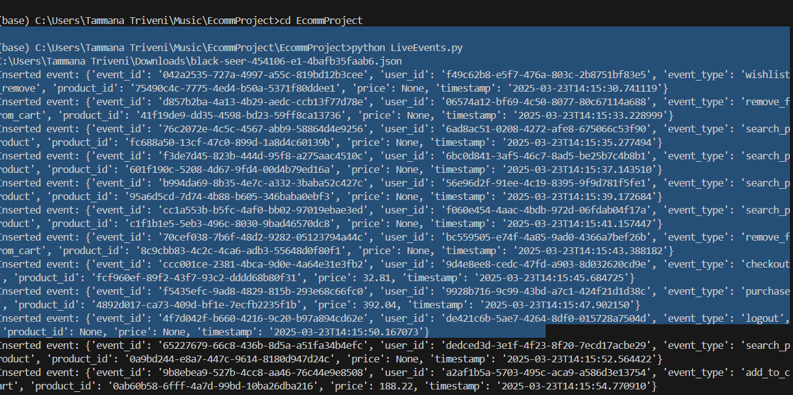
SnapShots
Live Events : Generating Live Events by creating event table in BigQuery and generating random values using Faker library

Slide 15
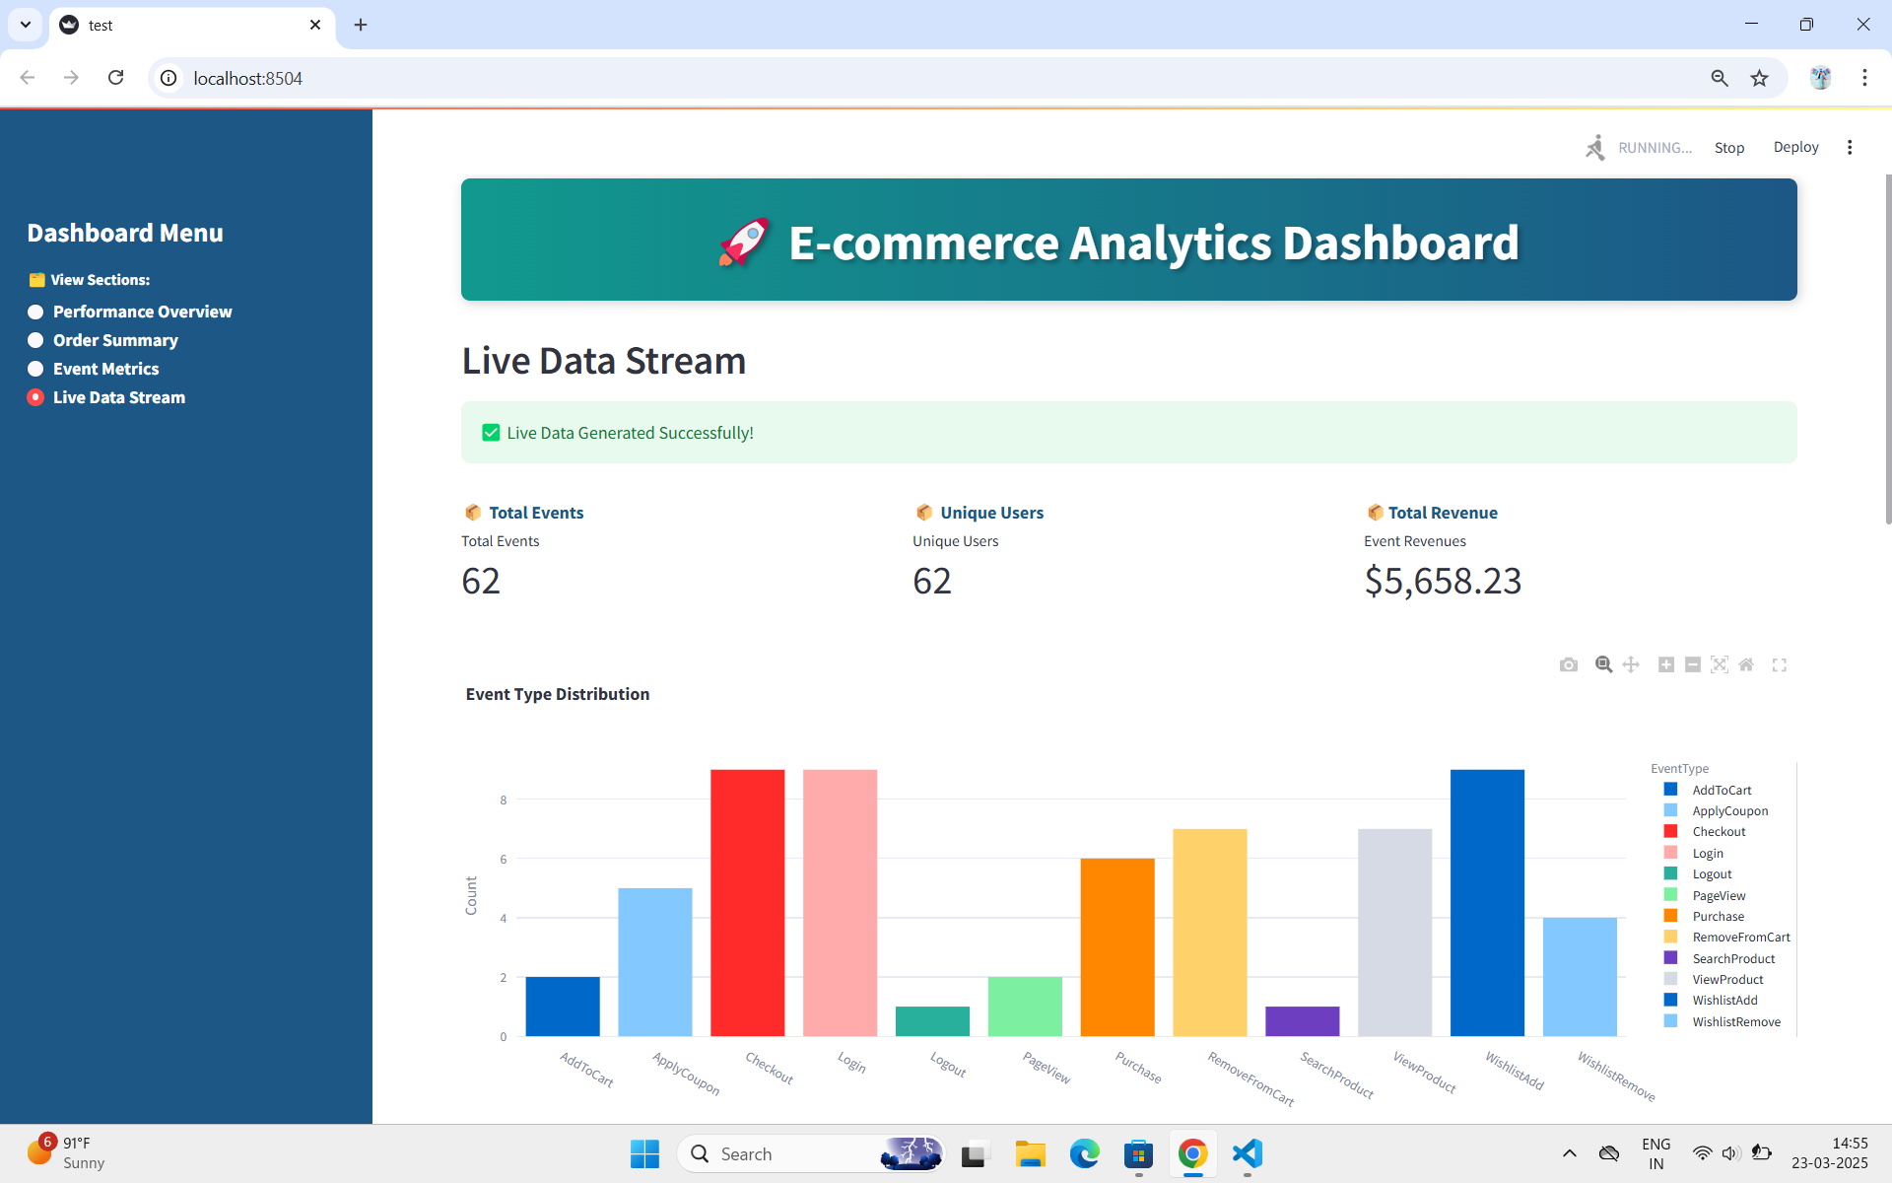
SnapShots
Live Data Stream: Showing Total Events,Unique Users and Total Revenues and Event
Distribution and showing Success message and saves logging info in app.log file

Slide 16
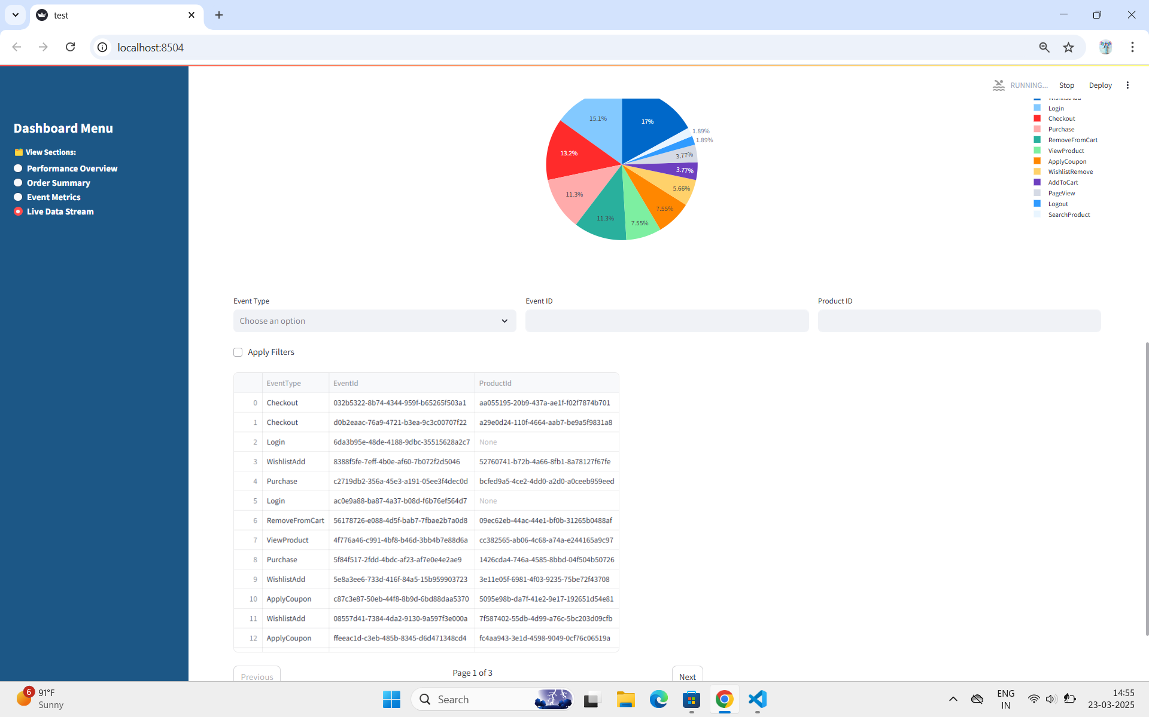
SnapShots
Live Data Stream: Showing Events Table of generating Live Events

Slide 17
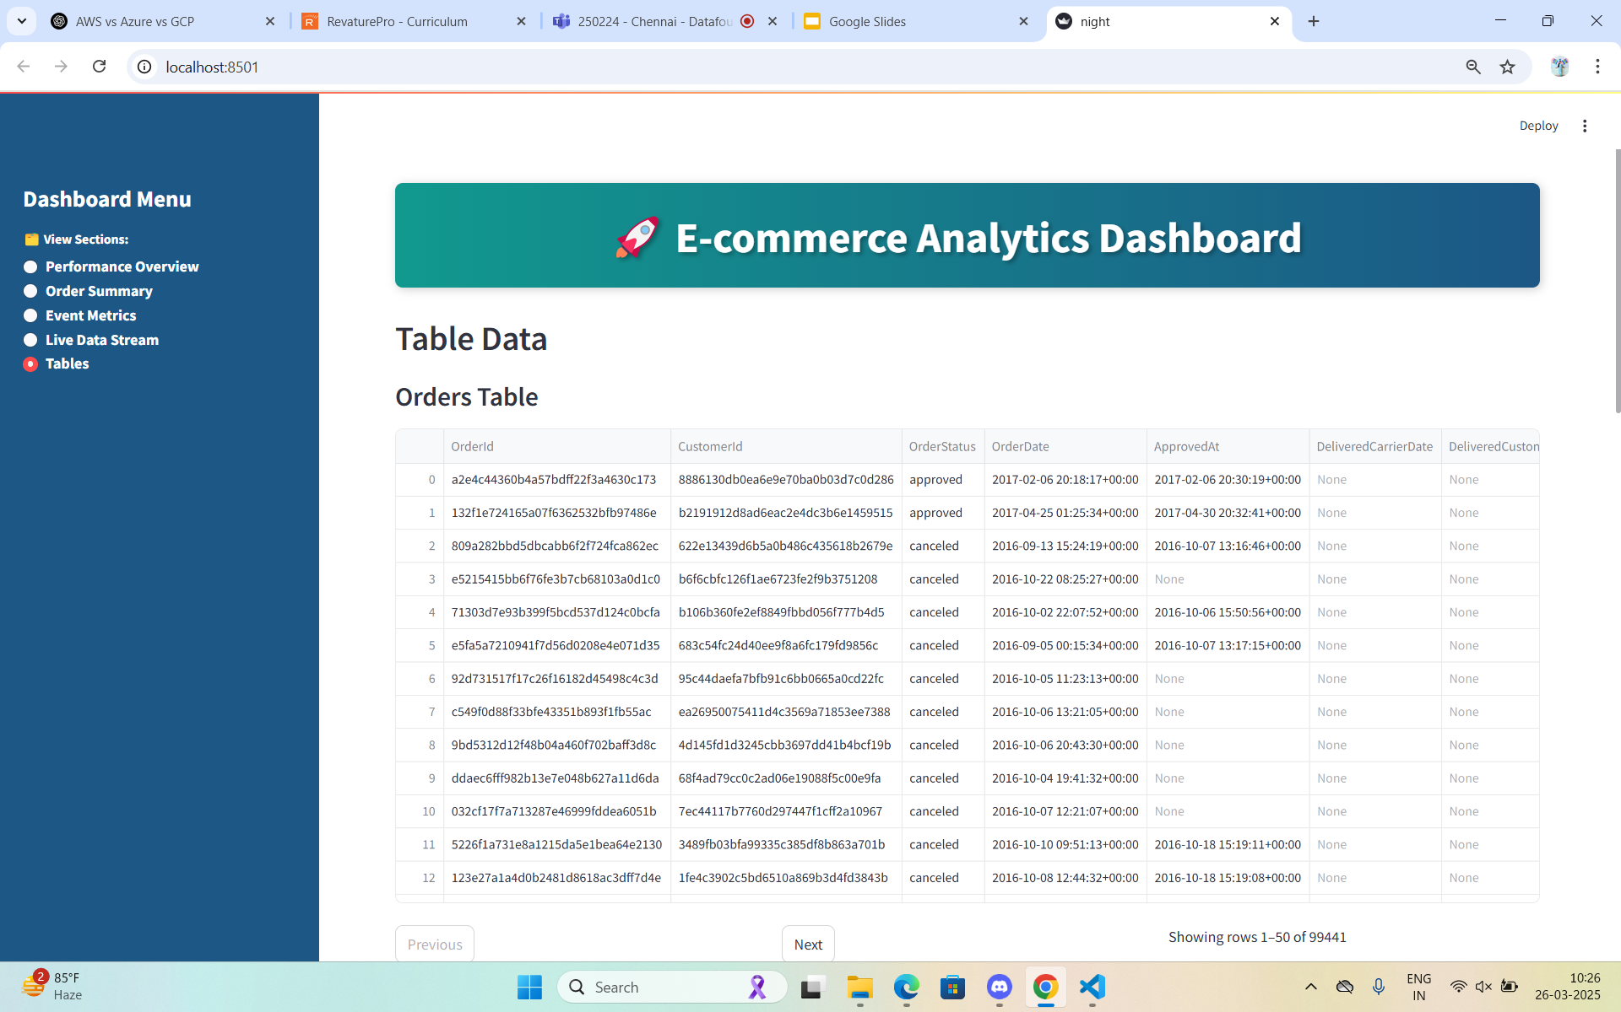
SnapShots
Tables: Shows Orders,Order items and customers Table preview

Slide 18
Conclusion
The Data Foundation: Event-driven Data Pipeline for E-commerce successfully integrates real-time and historical data processing to provide actionable insights for e-commerce businesses. By leveraging Python, Google BigQuery, and Streamlit, the system captures, processes, and visualizes key e-commerce metrics, enabling businesses to optimize their operations.
✅ Real-time & Historical Data Processing
Live event generation using Faker
Integration of Brazilian E-commerce Dataset
✅ Streamlit Dashboard Features
Performance Overview: Top 10 Best & Worst Products, Total Revenue, Total Orders, Active Customers
Order Summary: Order Status Distribution & Daily Order Trends
Event Metrics: Total Events, Unique Users, Event Types, Total Revenue
Live Data Stream: Real-time event tracking & logging in app.log

Slide 19

Future
Scope
Real-time alerts & notifications
Predictive analytics for customer behavior
Data Security & Privacy
Connection with other platforms
Reports Generation

Slide 20
Thank you Revature

